Slide 1
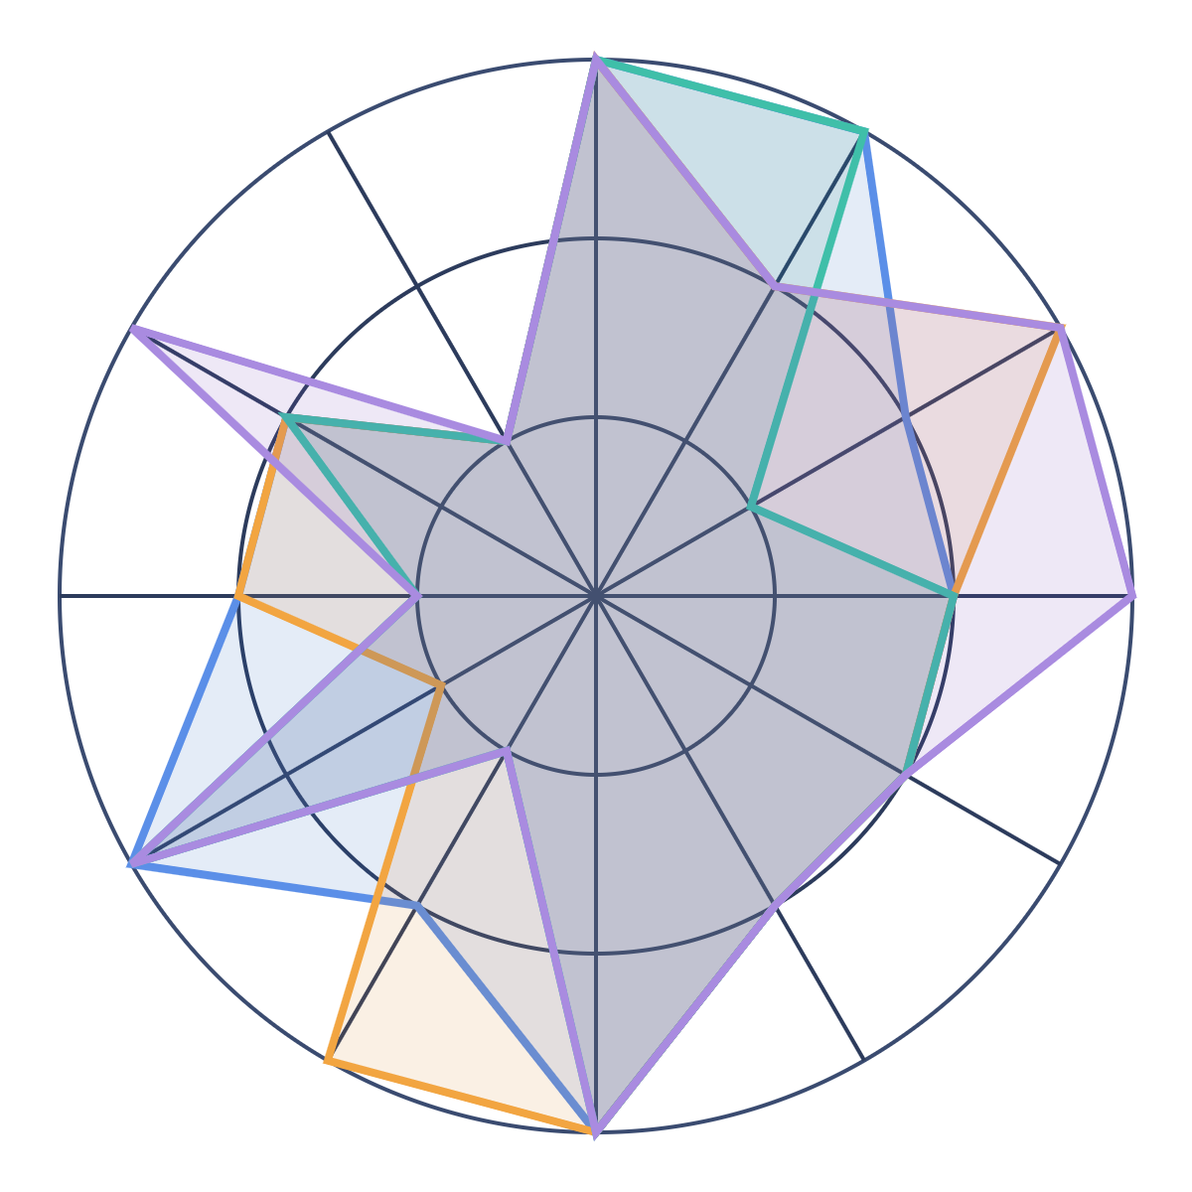




Which evaluation tool fits Llumino?
LLUMINO · TASK 2 · EVALUATION-AS-A-SERVICE
Braintrust
AWS AgentCore
Langfuse
Arize AX
Notes:
We compare four evaluation tools against the 12 things Llumino's Evaluation-as-a-Service has to do. The shape on the right is all four tools' scores laid over one chart. The bigger the shape, the more the tool covers. We'll break it apart on the coming slides.

Slide 2




A regular health check for every AI app
WHAT IT IS
Does it work?
Is it safe?
Does it still fit?
Accurate, reliable and worth the cost
Follows our safety, policy and privacy rules
Still does the job the business needs
The check keeps running, from the first build to live use.
Notes:
Evaluation-as-a-Service is a shared, company-wide way to test and watch AI models, apps and agents. It answers three questions. Does it work? Is it safe? Does it still fit the business? It is a recurring control, not a one-time test before launch. Each app gets its own versioned test suite.

Slide 3








Six steps that repeat
HOW IT WORKS
1
2
3
4
5
6
Onboard
Build
Qualify
Select
Monitor
Improve
Register the app, its goals and risks
Write tests and practice scenarios
Stop a release that got worse
ModelAdvisor picks the best model
Grade real use and flag changes
Turn every problem into a new test
Step 6 feeds back into step 2, so the tests get better every round.
Notes:
Onboard: register the app, its business goals, risks, owner, test data, scoring and pass marks. Build: create versioned offline tests, step-by-step agent tests, simulations and component tests. Qualify: compare with the pass marks and block a release that got worse. Select: use ModelAdvisor to compare approved models. Monitor: grade live traffic and trigger a review when something changes. Improve: turn live findings, human feedback, incidents and red-team results into permanent tests.

Slide 4




Four groups, one shared set of proof
WHO IT HELPS
Builders
AI Operations
Clear tests, and why they failed
One standard way to run and watch quality
Risk & Compliance
Business Owners
Proof the safety rules were tested
Proof the AI still does its job, plus a say in the test data
Notes:
Builders get repeatable tests, detailed failure evidence and clear release criteria. AI Operations gets standard evaluation operations, production scoring and evidence of ongoing quality. Risk, Compliance and Security get evidence that safety, policy, regulatory and control requirements were tested. Business owners get evidence the solution still meets its goal. They also feed their judgement back into the golden test data.

Slide 5















12 things a tool must do
THE SCORECARD
Must have (8)
Should have (3)
Extra (1)
Test sets
Release gates
Agent steps
Judge checks
Saved, versioned tests for each app
Block a release that got worse
Did the agent take the right path?
Make sure the AI grader is right
Onboarding
ModelAdvisor
Live scoring
Simulation
Register each app and its tests
Compare models, pick the best
Grade real conversations
Rehearse tricky scenarios safely
Human review
Red teaming
Tool & MCP
Salesforce
People label and correct scores
Attack it before others do
Test each tool on its own first
Connects with our Salesforce apps
Notes:
These 12 come from the capability slides. Eight are Must Have: evaluation suites (golden datasets), regression gates in CI, trajectory evaluation, judge governance, app onboarding and suite lifecycle, ModelAdvisor benchmarking, online/production scoring, and simulation. Three are Should Have: human annotation, red teaming, and component, tool and MCP evaluation. Salesforce Integration appears on the comparison chart, but no captured slide describes it, so check its exact meaning with the owning team.

Slide 6








Meet the four tools
THE CONTENDERS
Braintrust
AWS AgentCore
Langfuse
Arize AX
Buy
Already ours
Build (open source)
Buy (hosted)
Works with any cloud
Agent traces must be sent to AWS
Runs on our own servers, free
Strong at checking the AI grader
Logs and test data can stay in our account
Locks checks so nobody can change them
We run and maintain it ourselves
Hosted by Arize, built on OpenTelemetry
Notes:
Braintrust: works with any cloud and framework. In its hybrid setup, logs, experiments and datasets stay in our own cloud account, but Braintrust still runs the control plane and UI. Hybrid and self-hosting need the Enterprise plan, which is custom-priced. AgentCore Evaluations: already part of our AWS account. The agent does not have to run on AgentCore. It can run on ECS, EKS, Lambda or elsewhere, but its traces must be exported to CloudWatch in our AWS account using supported instrumentation. Once an evaluation is switched on, the custom evaluators it uses are locked: they cannot be edited or deleted until it is paused. Langfuse: MIT open source and free to self-host, including LLM-as-judge, datasets, experiments, annotation queues and an official GitHub Action for CI regression checks. We run and maintain it ourselves. Arize AX: hosted service built on OpenTelemetry/OpenInference, with strong evaluator management and agent tool-call evaluation. Verified against vendor docs on 2026-10-05.

Slide 7
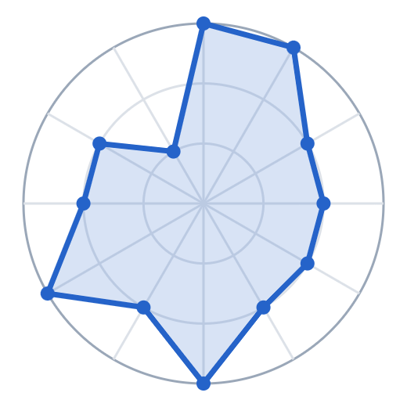

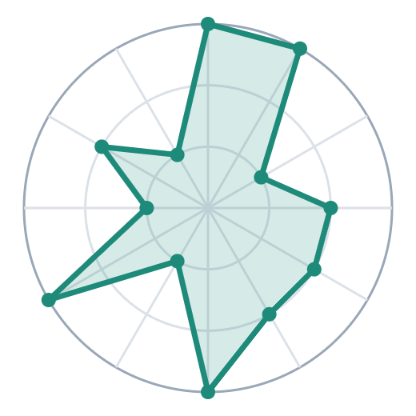
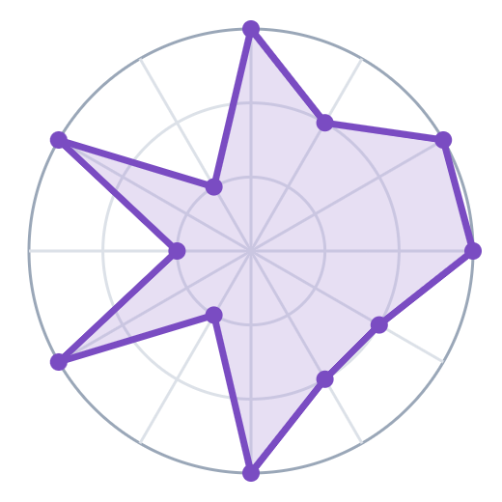
The capability map: bigger shape, more covered
Braintrust · 27 / 36
AWS AgentCore · 26 / 36
Test sets
Test sets
Salesforce
Release gates
Salesforce
Release gates
Tool & MCP
Agent steps
Tool & MCP
Agent steps
Red teaming
Judge checks
Red teaming
Judge checks
Human review
Onboarding
Human review
Onboarding
Simulation
ModelAdvisor
Simulation
ModelAdvisor
Live scoring
Live scoring
Langfuse · 24 / 36
Arize AX · 27 / 36
Test sets
Test sets
Salesforce
Release gates
Salesforce
Release gates
Tool & MCP
Agent steps
Tool & MCP
Agent steps
Red teaming
Judge checks
Red teaming
Judge checks
Human review
Onboarding
Human review
Onboarding
Simulation
ModelAdvisor
Simulation
ModelAdvisor
Live scoring
Live scoring
Rings: 1 = weak · 2 = partial · 3 = strong. Scores read from the team's comparison chart.
Notes:
This redraws the team's spider map, one chart per tool, using the same 12 capabilities. Each point is scored from 1 (weak) to 3 (strong), so a bigger shape means more coverage. Braintrust and Arize AX tie at 27, AgentCore has 26 and Langfuse 24. The totals are close. What differs is the shape, meaning which things each tool does well. The scores were read by eye from the original chart, so treat them as approximate.

Slide 8
Every score in one view
SIDE BY SIDE
Capability
Braintrust
AWS AgentCore
Langfuse
Arize AX
Test sets
3 · Strong
3 · Strong
3 · Strong
3 · Strong
Release gates
3 · Strong
2 · Partial
3 · Strong
2 · Partial
Agent steps
2 · Partial
3 · Strong
1 · Weak
3 · Strong
Judge checks
2 · Partial
2 · Partial
2 · Partial
3 · Strong
Onboarding
2 · Partial
2 · Partial
2 · Partial
2 · Partial
ModelAdvisor
2 · Partial
2 · Partial
2 · Partial
2 · Partial
Live scoring
3 · Strong
3 · Strong
3 · Strong
3 · Strong
Simulation
2 · Partial
3 · Strong
1 · Weak
1 · Weak
Human review
3 · Strong
1 · Weak
3 · Strong
3 · Strong
Red teaming
2 · Partial
2 · Partial
1 · Weak
1 · Weak
Tool & MCP
2 · Partial
2 · Partial
2 · Partial
3 · Strong
Salesforce
1 · Weak
1 · Weak
1 · Weak
1 · Weak
Notes:
This is the same data as the spider map, as a grid. Dark blue means strong, light blue partial, and orange weak. Look across a row to see who leads on each capability. All four are strong on test sets and live scoring. All four are only partial on onboarding and ModelAdvisor, and weak on Salesforce.

Slide 9

The scores are close, so the totals can't decide this
THE TOTALS
Braintrust
27 / 36
Arize AX
27 / 36
AWS AgentCore
26 / 36
Langfuse
24 / 36
Only 3 points separate the four. What matters is which things each tool does well.
Notes:
Each tool can score up to 36: 12 capabilities times 3 points. Braintrust and Arize AX score 27, AgentCore 26 and Langfuse 24. The gap from top to bottom is only 3 points, so the totals can't decide this. The next slide shows where each tool is strong and weak.

Slide 10



Each tool is good at different things
THE REAL DIFFERENCE
All four are strong at test sets and live scoring, and weak at Salesforce.
Braintrust
AWS AgentCore
Langfuse
Arize AX
BEST AT
BEST AT
BEST AT
BEST AT
Release gates
Agent steps
Release gates
Judge checks
Human review
Simulation
Human review
Tool & MCP
WEAKER AT
WEAKER AT
WEAKER AT
Agent steps
Nothing scored weak
Human review
Agent steps
Human review
Simulation
WEAKER AT
Red teaming
Simulation
Red teaming
Notes:
"Best at" lists every capability where a tool scores 3 out of 3. "Weaker at" lists every capability where it scores 1. Capabilities that are the same for all four are left off the cards: all are strong at test sets and live scoring, and all are weak at Salesforce. Braintrust is strong at release gates and human review, and none of its other scores is a 1. AgentCore is strong at agent steps and simulation, but weak at human review. Langfuse is strong at release gates and human review, but weak at agent steps, simulation and red teaming. Arize AX is strong at agent steps, judge checks, human review and tool/MCP testing, but weak at simulation and red teaming.

Slide 11




No tool fully covers these four.
Llumino builds them.
THE GAP
Onboarding
ModelAdvisor
Red teaming
Salesforce
Best score: 2 of 3
Best score: 2 of 3
Best score: 2 of 3
Best score: 1 of 3
Notes:
This is the key finding for the gap analysis. Whichever tool we pick, these four stay with Llumino. First, app onboarding and suite lifecycle: registering each app, linking each release to the exact test version, and freshness triggers. Second, ModelAdvisor: a controlled model comparison and a scorecard. Third, red teaming: recurring attack tests with tracked fixes. Fourth, the Salesforce integration. These are the build backlog no matter which tool we buy.

Slide 12


Two questions pick the tool
HOW TO CHOOSE
QUESTION 1
No
QUESTION 2 · IF THE ANSWER TO QUESTION 1 IS NO
Can all our agents send their traces to AWS?
Must everything run on our own servers, and can we run it ourselves?
Yes
Yes
No
No
Q1: Yes
Q2: Yes
Q2: No + need speed
Q2: No + judge checks
AWS AgentCore
Langfuse
Braintrust
Arize AX
Already in our AWS account. Once a check is switched on it is locked, so nobody can quietly change it.
Free and open source. AI judges, test sets, review queues and CI checks all run on our servers.
Any cloud, any framework. Logs and test data stay in our account. Blocks bad releases in CI.
Only tool rated strong on both AI-grader and tool/MCP checks. Reusable judges in its Eval Hub.
Notes:
Two questions decide this. Question 1: can all our agents send their traces to CloudWatch in our AWS account, using supported instrumentation such as Strands or LangGraph with OpenTelemetry? The agents can run anywhere. If yes, AgentCore. It is already in our AWS account, and once an evaluation is switched on, the custom evaluators it uses are locked: they cannot be edited or deleted until it is paused. If no, Question 2: must everything run on our own servers, and can we run it ourselves? If yes, Langfuse. It is MIT open source, and LLM-as-judge, datasets, annotation queues and an official CI GitHub Action are all free to self-host. If no, choose by priority. Pick Braintrust for speed and coverage: it works with any cloud and framework, keeps logs and test data in our account in its hybrid setup, and posts improvements and regressions on every pull request. Pick Arize AX if checking the AI grader matters most: it is the only tool the team chart rates 3 on both judge governance and tool/MCP evaluation, and its Eval Hub manages reusable LLM-judge, code and agent-as-judge evaluators. Facts verified against vendor docs on 2026-10-05; ratings come from the team's comparison chart.

Slide 13









Two weeks of demo calls with all four vendors
WHAT HAPPENS NEXT
October 12 to 23, 2026
Week 1
Oct 12–16
Week 2
Oct 19–23
Book a call with each vendor
Calls with Langfuse and Arize AX
Send them our question list
Compare notes and prices side by side
Calls with Braintrust and AWS AgentCore
Share findings with the team (Oct 23)
We ask each one:
How it works
Live demo
Pricing
Where our data lives
Notes:
Over the next two weeks we talk to someone at each of the four companies: Braintrust, AWS (AgentCore Evaluations), Langfuse and Arize AX. Week 1: book the calls, send each vendor our question list in advance, and hold the first two calls. Week 2: hold the other two calls, put everyone's answers and prices side by side, and share the findings with the team on October 23. On every call we ask how the tool works, ask for a live demo on an agent like ours, get pricing for our volume, and confirm where our data is stored. The call order is a suggestion; it can change with vendor availability.

